Slide 1
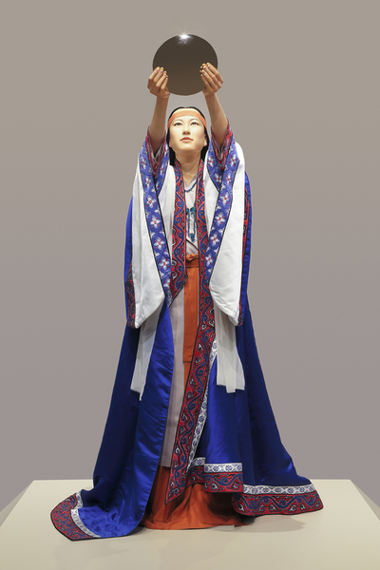
What to Make of Himiko? Akiko Yoshie, Emerita Professor, Teikyô University
Presented by The Shinso Ito Center of Japanese Religion and Culture
The Project for Premodern Japan Studies at USC

Slide 2
Introducing Prof. Akiko Yoshie
At USC, 2013

Slide 3
Born in 1948, Yoshie Akiko graduated from the Tokyo University of Education in 1971. While raising a family, she completed coursework for the doctorate in 1979 and received her Doctor of Letters degree from Tokyo Metropolitan University in 1987. Her dissertation was entitled, ”The Structure of the Uji Kin Group in Classical Japan” 『日本古代の氏の構造』. Yoshie was appointed Assistant Professor at Teikyô University in 1992 and promoted to Full Professor in 1999. Having retired in 2013, she is now Professor Emerita at Teikyô University.
Her main publications and prizes include:
1986 The Structure of the Uji Kin Group in Classical Japan『日本古代の氏の構造』Yoshikawa Kôbunkan 1996 Ritual and Women in Classical Japan 『日本古代の祭祀と女性』Yoshikawa Kôbunkan (*Aoyama Prize for Women’s History) 2000 How Genealogies Were Made in Classical Japan『日本古代系譜様式論』Yoshikawa Kôbunkan 2005 The Making of Himiko『つくられた卑弥呼』Chikuma Shinsho Chikuma Shobô
2011 Classical Kingship 『 古代王権論』Iwanami shoten 2017 Female Monarchs in Classical Japan 『日本古代女帝論』Hanawa Shobô (*Kadokawa Genyoshi Prize) 2020 Suiko Tennô, The Monarch Suiko『推古天皇』Minerva Shobô 2021 Female Monarchs in Classical Kingship, a History『女帝の古代王権史』Chikuma Shinsho Chikuma Shobô

Slide 4
As her publications indicate, Prof. Yoshie has long taken deep interest in the social roles of women from Yayoi into classical times — she calls her approach, “joseitachi no sugata wo horiokoshi” — excavating the lives of women in history, through studies of family structure, including the structures and processes of marriage, succession, inheritance, and keeping genealogies.
I am happy to recall that she and I have been able to work together to translate parts of Japan’s earliest extant law codes (the Yôrô ritsuryô), which have proven helpful in exploring issues of family organization and gender relations in Nara times (cf. the PPJS website, page on Ritsuryô Research).
In recent years, Prof. Yoshie has focused her research more on female rulership and social leadership in both protohistorical and early classical society. Several translations into English of her work are available. A particularly good example of is in Monumenta Nipponica. Do take a look.

Slide 5
Prof. Yoshie uses primary source analysis as well as archaeological and linguistic evidence to learn about women’s social roles, both at the center and in the periphery.
As she will tell you more about today, in 2005 she published her book Tsukarareta Himiko (The Invented History of Himiko), which she considers to be her first book “that applies concepts of gender analysis to her research.” Therein, she tells readers about her excavation of Himiko and her society in third-century Yamatai, correcting parts of the story that she thinks have been misunderstood. She will also explain why she thinks that the stories of Himiko and Yamatai are relevant still, because they influence structures and social attitudes that still shape law and attitudes to gender and gender relations in Japan (and of Japan) today.
“Getting it right matters,” says Prof. Yoshie.

