Slide 1
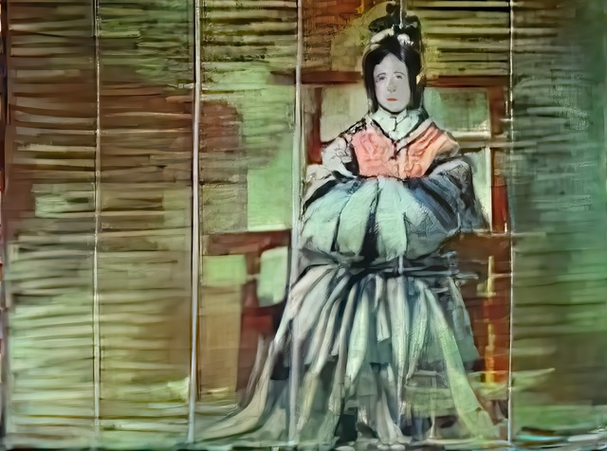
Who was Suiko, and Why It Matters? Akiko Yoshie, Professor Emerita, Teikyô University
Presented by The Shinso Ito Center of Japanese Religion and Culture
& The Project for Premodern Japan Studies at USC

Slide 2
Welcome to today’s Shinso Ito Center lecture on Great King Suiko by Prof. Akiko Yoshie, Emerita Professor, Teikyô University.
This is the second of two lectures by Professor Yoshie on female rulers and rulership in early Japan.
Prof. Bryan Lowe of Princeton is with us as well as discussant.

Slide 3
Introducing Prof. Yoshie

Slide 4
Born in 1948, Yoshie Akiko graduated from the Tokyo University of Education in 1971. While raising a family, she completed doctoral studies in 1979 and received her PhD from Tokyo Metropolitan University in 1987. Her dissertation was entitled, ”The Structure of the Uji Kin Group in Classical Japan” 『日本古代の氏の構造』. She was appointed Assistant Professor at Teikyô University in 1992 and promoted to Full Professor in 1999. Having retired in 2013, she is now Professor Emerita at Teikyô University.
Her main publications and prizes include:
1986 The Structure of the Uji Kin Group in Classical Japan『日本古代の氏の構造』Yoshikawa Kôbunkan 1996 Ritual and Women in Classical Japan 『日本古代の祭祀と女性』Yoshikawa Kôbunkan (*Aoyama Prize for Women’s History) 2000 How Genealogies Were Drawn in Classical Japan『日本古代系譜様式論』Yoshikawa Kôbunkan 2005 The Invented History of Himiko『つくられた卑弥呼』Chikuma Shinsho Chikuma Shobô
2011 Classical Kingship 『 古代王権論』Iwanami shoten 2017 On Female Monarchs in Classical Japan 『日本古代女帝論』Hanawa Shobô (*Kadokawa Genyoshi Prize) 2020 Suiko Tennô, The Monarch Suiko『推古天皇』Minerva Shobô 2021 Female Monarchs in Classical Kingship, a History『女帝の古代王権史』Chikuma Shinsho Chikuma Shobô

Slide 5
Prof. Yoshie has long taken deep interest in the social roles of women from Yayoi into classical times — she calls her approach, “joseitachi no sugata wo horiokoshi” 女性達の姿を掘り起こし— “excavating the lives of women in history,” through studies of family structure, including marriage, succession and inheritance, and genealogical formation.
I am happy to recall that she and I worked together with Dr. Yôko Ijûin to translate, annotate, and analyze parts of Japan’s earliest extant law codes, the Yôrô ritsuryô, as a means of exploring issues of family organization, gender relations, and state formation in Nara times (cf. PPJS website <uscppjs.org>, Research/ Ritsuryô). This project opened up the study of classical Japanese law in an East Asian context to a global audience.
In recent years, Prof. Yoshie has focused particularly on studying the nature of female rulership and leadership in protohistorical and classical times. An excellent English translation of her work is “Gender in Early Classical Japan” in Monumenta Nipponica 60.4 (2005). We will also put links for the Japanese and English texts of her two Shinso Ito lectures on our PPJS website, at <uscppjs.org>.

Slide 6
Prof. Yoshie uses primary source analysis as well as archaeological and linguistic evidence to learn about women’s social roles at the center and beyond. She is constantly aware of the importance of gender issues. Her work is at the leading edge of historical studies in Japan today.
As she will tell you today, in 2020 she published her book on Suiko. Surprisingly, hers was the first book-length study of Japan’s first female great king. She will tell us why Suiko’s “name recognition” is low, what we can know about Suiko from which sources, and how can we can read and interpret those sources.

Slide 7
Yoshie’s use of the Nihon shoki 日本書紀 for her research is of particular interest. She provides good counsel on how best to use this early eighth-century chronicle, often termed a “myth-history,” to excavate strands of Great King Suiko’s story, while peering through shadows cast by Prince Shôtoku’s growing hagiography when it was compiled [cf. W.G. Aston’s English translation, Nihongi]

Slide 8
Finally, Professor Yoshie will also give us her thoughts as to why Suiko’s story, and that of Yamato kingship of her time, needs rewriting, and why those of us who teach and write about Japan’s history need to correct the misinformation and lack of information about Suiko and other female sovereigns in the textbooks and materials we use in our classrooms.

Slide 9
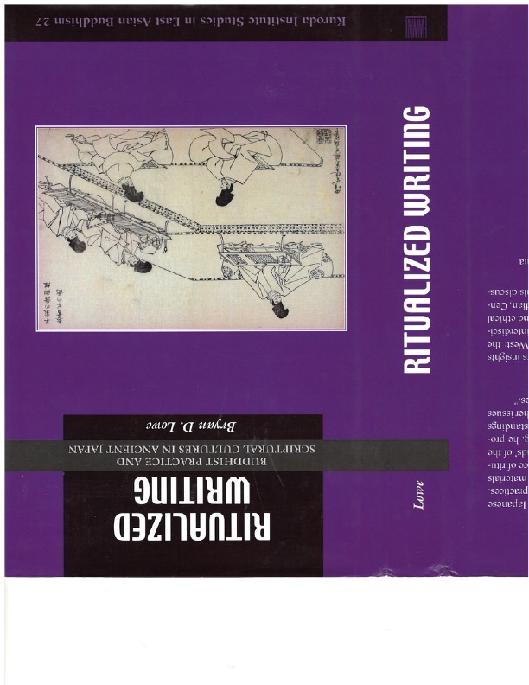
Happily Prof. Bryan Lowe of Princeton University is also with us today, to act as discussant and share his thoughts and questions on Professor Yoshie’s research.
As many of you will know from reading his wonderful book Ritualized Writing (2017) and numerous articles, Prof. Lowe studies Buddhism in early classical Japan. He describes his own work as “challenging elite-centered narratives,” interdisciplinary, and focused on Buddhism as it was “lived and practiced by individuals and communities from diverse backgrounds.”
Given Suiko’s important role in making Buddhism flourish, Prof. Lowe is a great discussant for our lecture today. Thank you for accepting my invitation, Professor Lowe!

Slide 10
We hope that after Prof. Yoshie’s lecture and Prof. Lowe’s comments today, many of you in the audience will have questions and opinions to voice as well.
And we hope that in future, conversations between researchers inside and outside Japan in a bilingual setting like this one will increase, bringing ever more knowledge about Japan and interest in it to a broader audience across the globe!

Slide 11
Selected Bibliography
• Joan R. Piggott, The Emergence of Japanese Kingship, 1997
• Donald Philippi, Kojiki, 1969
• Gustav Heldt, The Kojiki, An Account of Ancient Matters, 2014
• W. G. Aston, Nihongi, Chronicles of Japan, 1972
• L. Carrington Goodrich, Japan in Chinese Dynastic Histories, 1951
•John R. Bentley, Historiographical Trends in Early Japan, 2002
• Torquil Duthie, Manyôshû and the Imperial Imagination in Early Japan, 2014
•Kokuritsu Rekishi Minzoku Hakubutsukan, Seisa (genda-) no Nihonshi, 2020
•Yoshimura Takehiko, Nihon kodai no seiji to shakai, 2021
•Nitô Atsushi, “Kodai joteiron no genjô to kadai,” Rekishi hyôron 642 (2003); “Bansei ikkei”ron to jotei, kôtaishi,” Rekishigaku kenkyû 1004 (2021)

